Slide 1
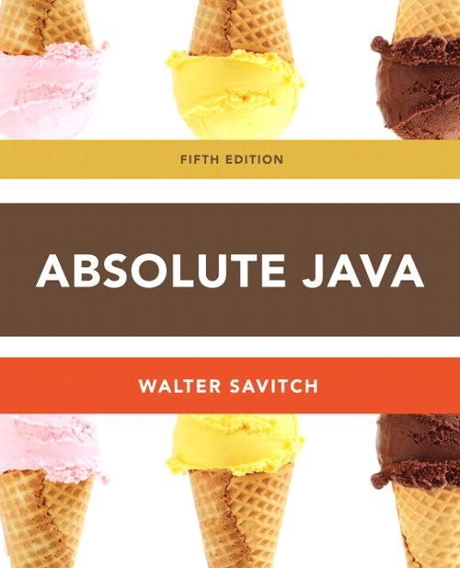
Chapter 14
Generics
Slides prepared by Rose Williams, Binghamton University
Kenrick Mock, University of Alaska Anchorage

Slide 2
Introduction to Generics
Beginning with version 5.0, Java allows class and method definitions that include parameters for types
Such definitions are called generics
Generic programming with a type parameter enables code to be written that applies to any class

Slide 3
Generics
Classes and methods can have a type parameter
A type parameter can have any reference type (i.e., any class type) plugged in for the type parameter
When a specific type is plugged in, this produces a specific class type or method
Traditionally, a single uppercase letter is used for a type parameter, but any non-keyword identifier may be used

Slide 4
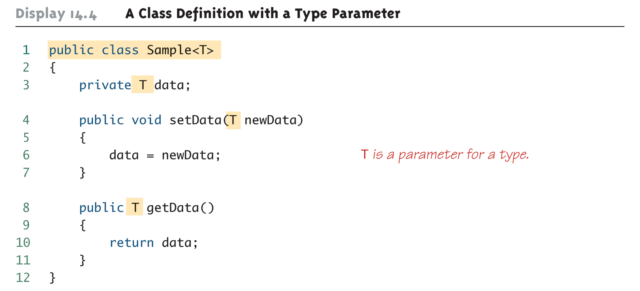
A Class Definition with a Type Parameter

Slide 5
Class Definition with a Type Parameter
A class that is defined with a parameter for a type is called a generic class or a parameterized class
The type parameter is included in angular brackets after the class name in the class definition heading
Any non-keyword identifier can be used for the type parameter, but by convention, the parameter starts with an uppercase letter
The type parameter can be used like other types used in the definition of a class

Slide 6
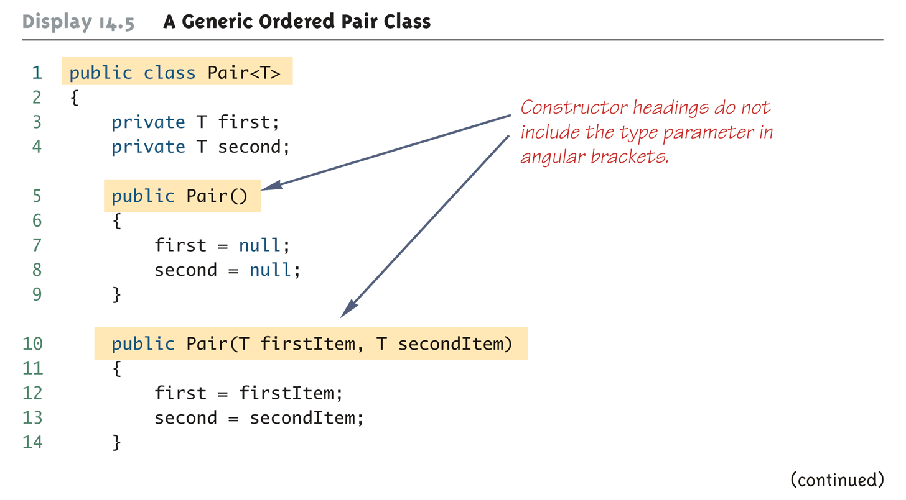
A Generic Ordered Pair Class (Part 1 of 4)

Slide 7
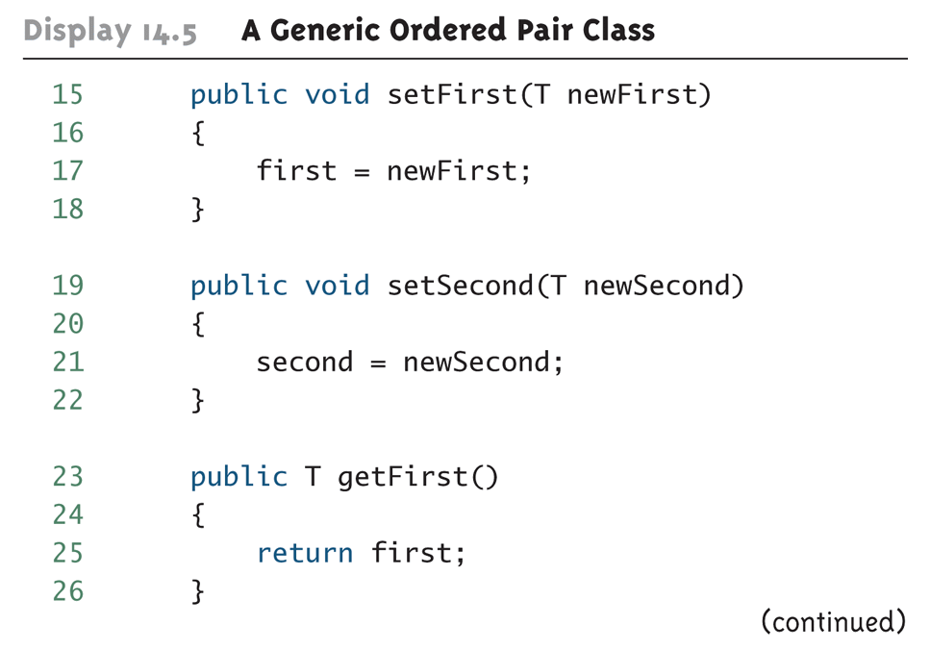
A Generic Ordered Pair Class (Part 2 of 4)

Slide 8
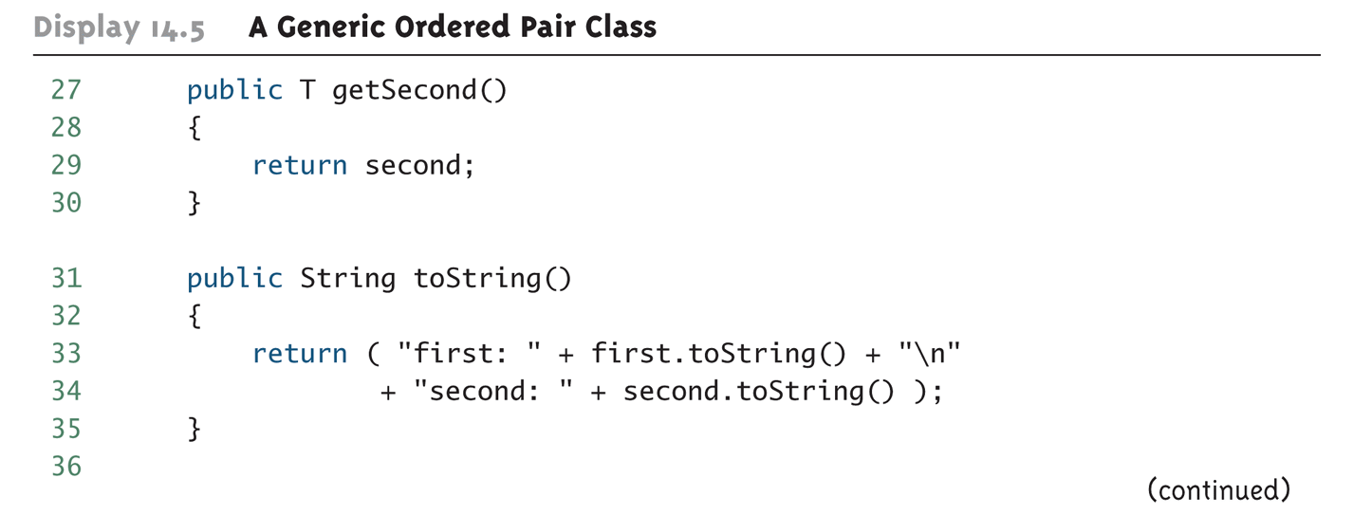
A Generic Ordered Pair Class (Part 3 of 4)

Slide 9
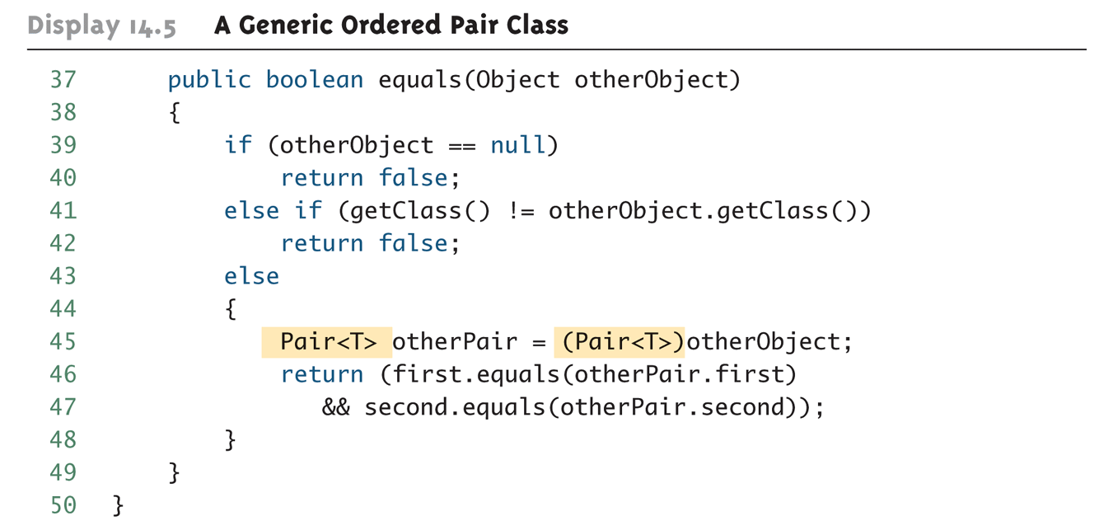
A Generic Ordered Pair Class (Part 4 of 4)

Slide 10
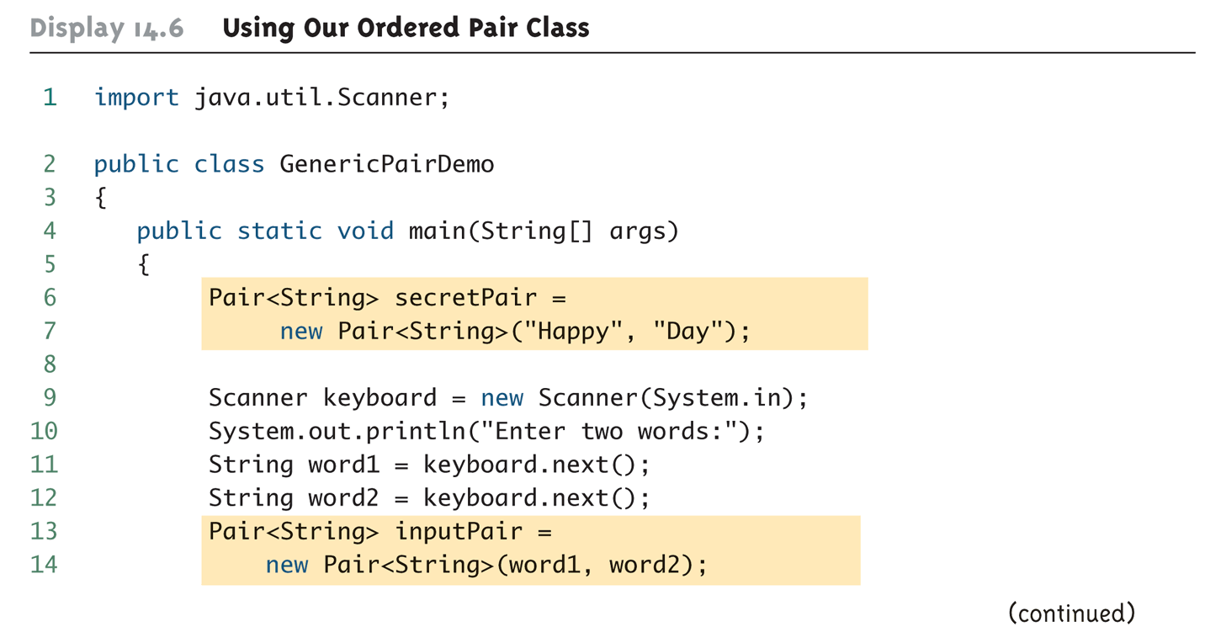
Using Our Ordered Pair Class (Part 1 of 3)

Slide 11
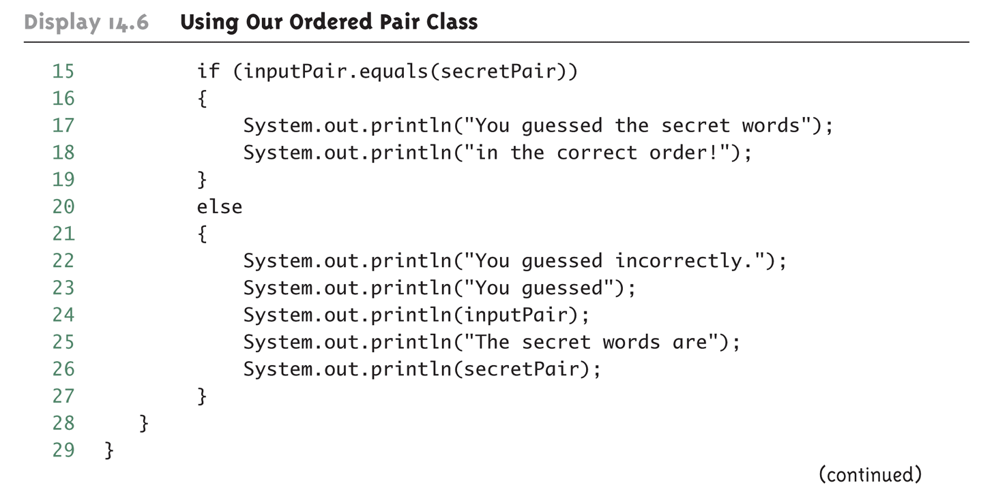
Using Our Ordered Pair Class (Part 2 of 3)

Slide 12
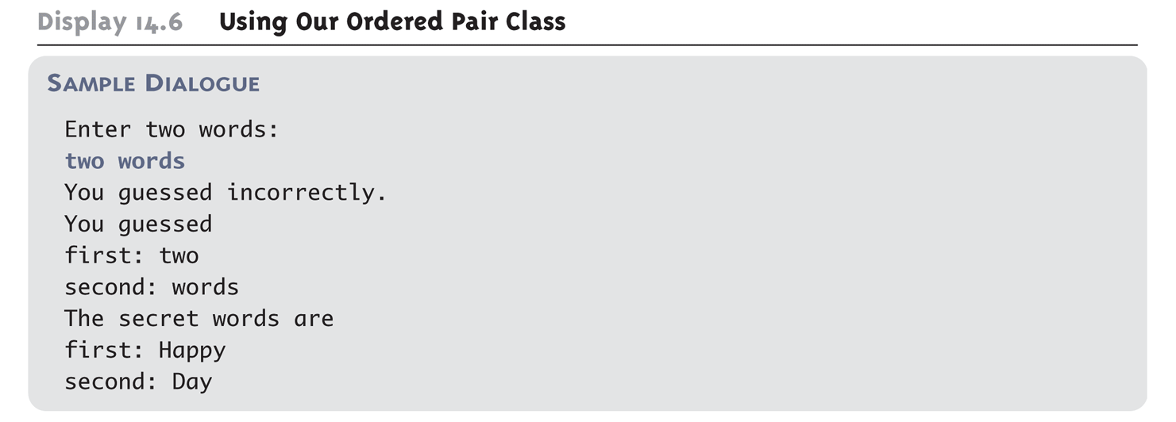
Using Our Ordered Pair Class (Part 3 of 3)

Slide 13
Pitfall: A Generic Constructor Name Has No Type Parameter
Although the class name in a parameterized class definition has a type parameter attached, the type parameter is not used in the heading of the constructor definition
public Pair<T>()
A constructor can use the type parameter as the type for a parameter of the constructor, but in this case, the angular brackets are not used
public Pair(T first, T second)
However, when a generic class is instantiated, the angular brackets are used
Pair<String> pair =
new Pair<STring>("Happy", "Day");

Slide 14
Pitfall: A Primitive Type Cannot be Plugged in for a Type Parameter
The type plugged in for a type parameter must always be a reference type
It cannot be a primitive type such as int, double, or char
However, now that Java has automatic boxing, this is not a big restriction
Note: reference types can include arrays

Slide 15
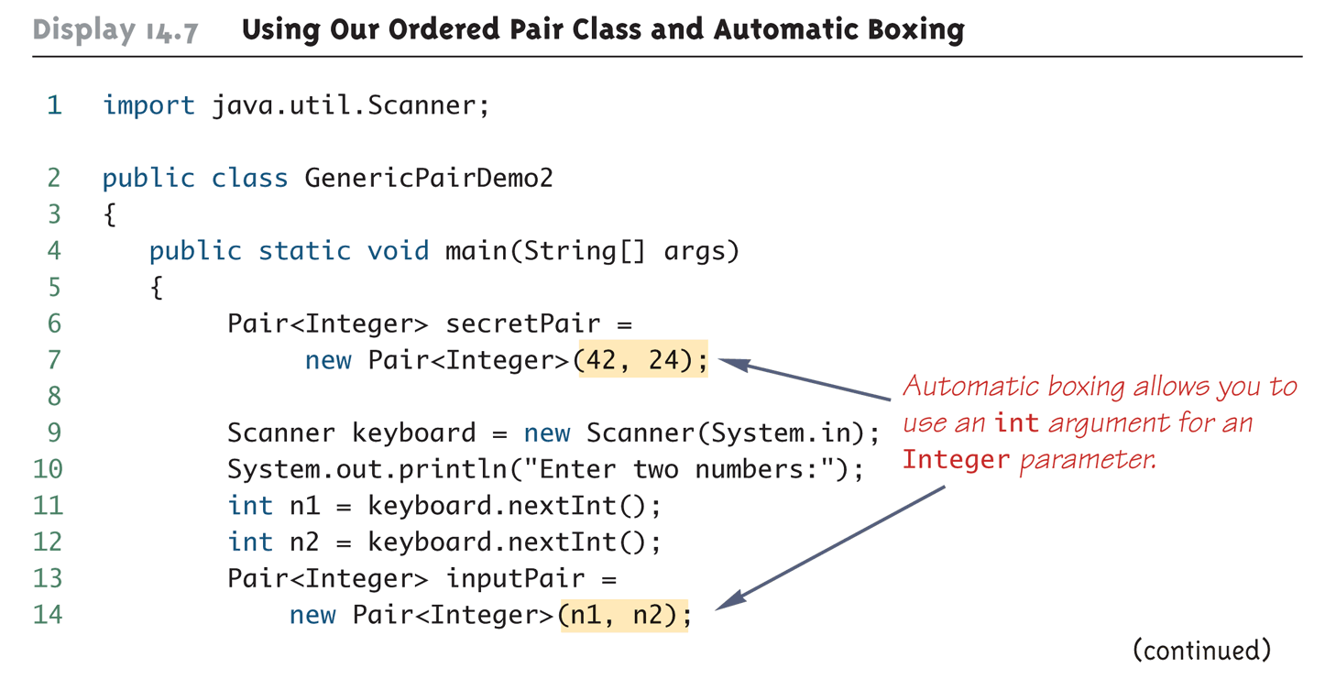
Using Our Ordered Pair Class and Automatic Boxing (Part 1 of 3)

Slide 16
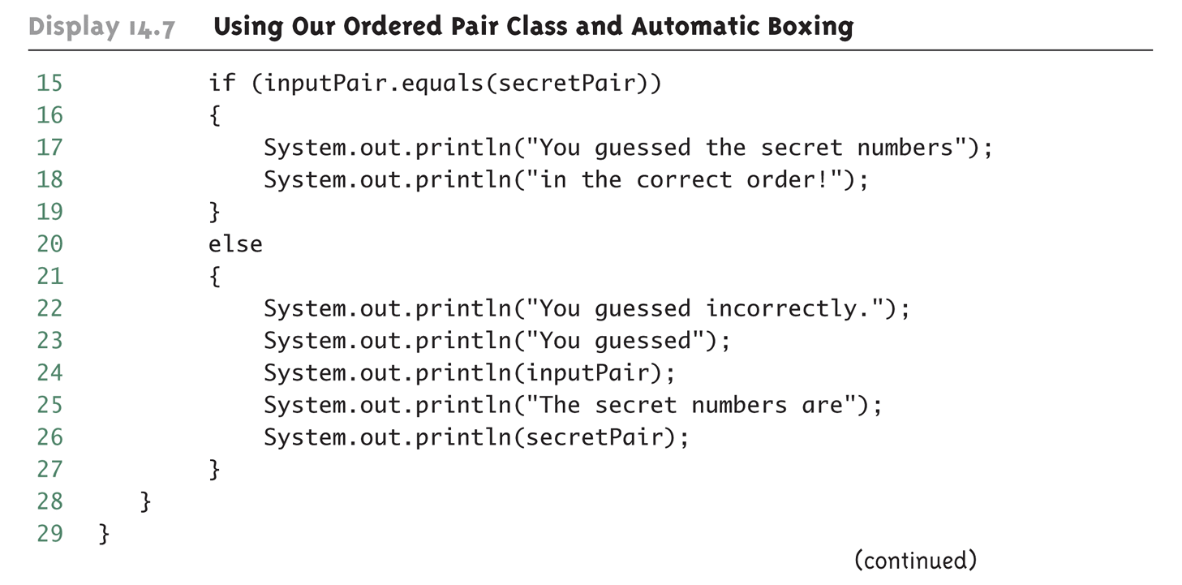
Using Our Ordered Pair Class and Automatic Boxing (Part 2 of 3)

Slide 17
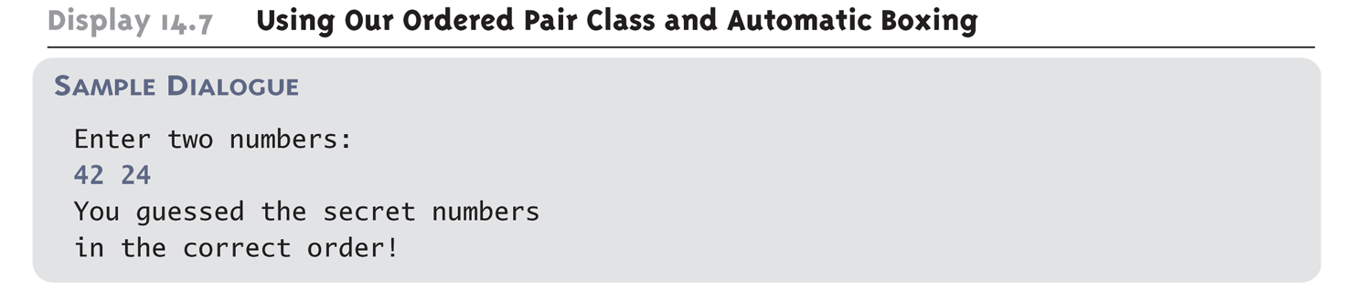
Using Our Ordered Pair Class and Automatic Boxing (Part 3 of 3)

Slide 18
Pitfall: A Class Definition Can Have More Than One Type Parameter
A generic class definition can have any number of type parameters
Multiple type parameters are listed in angular brackets just as in the single type parameter case, but are separated by commas

Slide 19
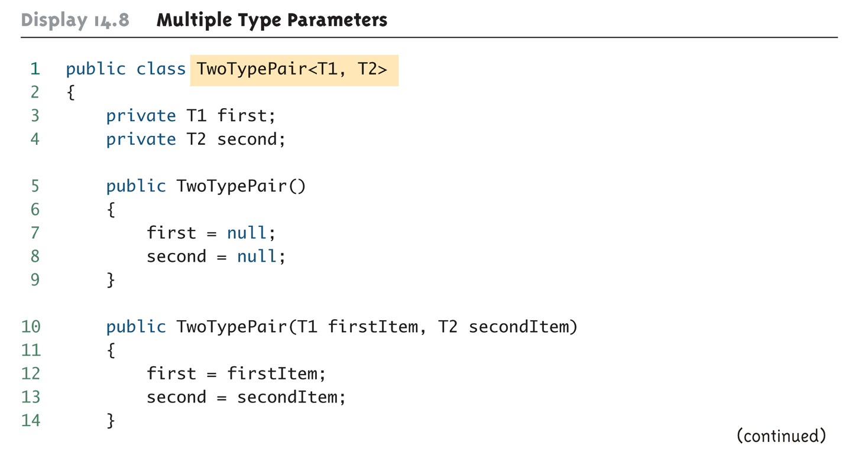
Multiple Type Parameters (Part 1 of 4)

Slide 20
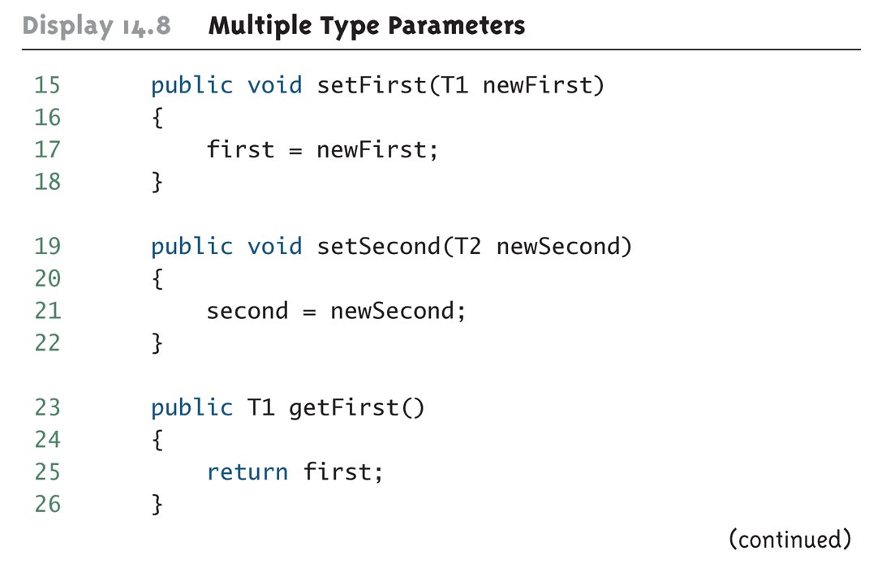
Multiple Type Parameters (Part 2 of 4)

Slide 21
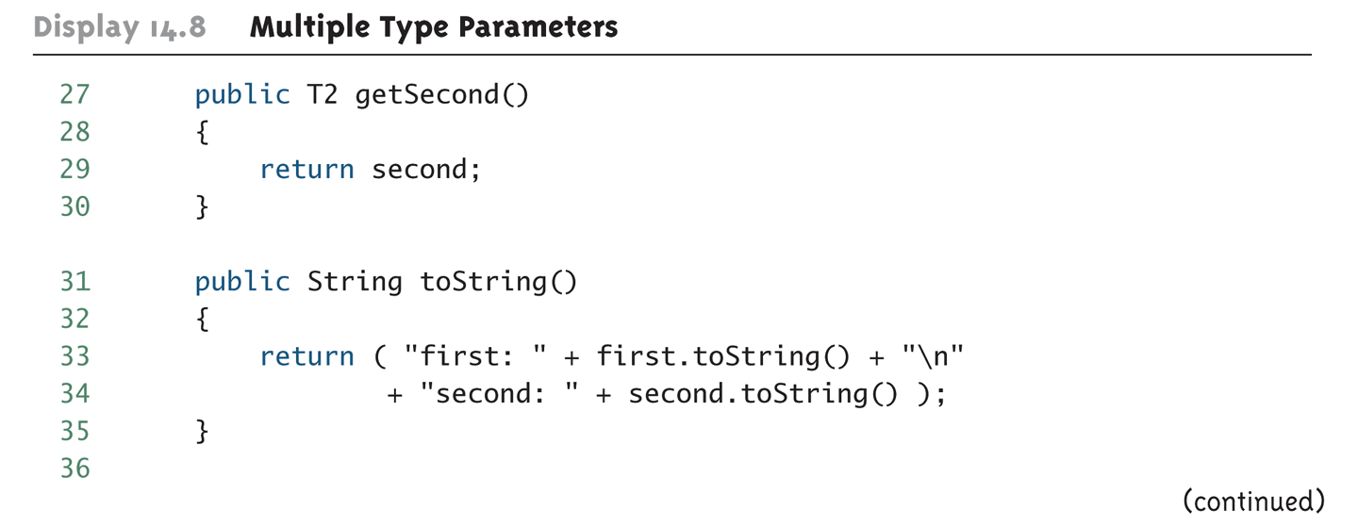
Multiple Type Parameters (Part 3 of 4)

Slide 22
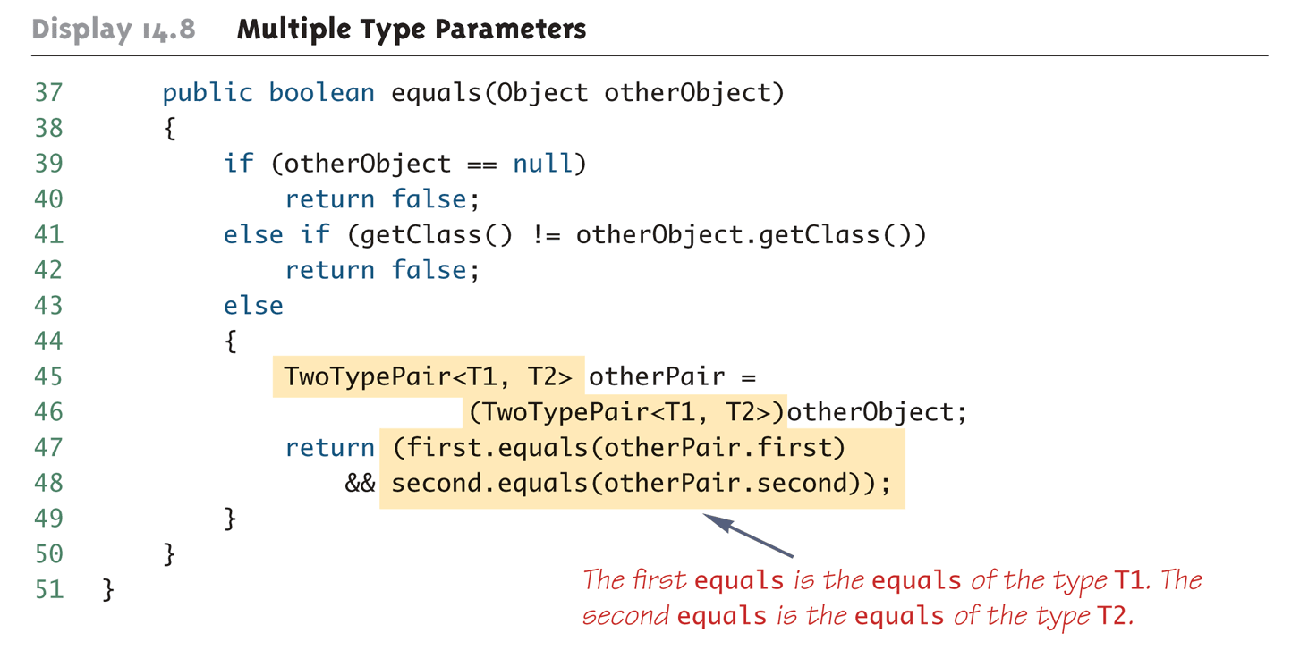
Multiple Type Parameters (Part 4 of 4)

Slide 23
Pitfall: A Generic Class Cannot Be an Exception Class
It is not permitted to create a generic class with Exception, Error, Throwable, or any descendent class of Throwable
A generic class cannot be created whose objects are throwable
public class Gex<T> extends Exception
The above example will generate a compiler error message

Slide 24
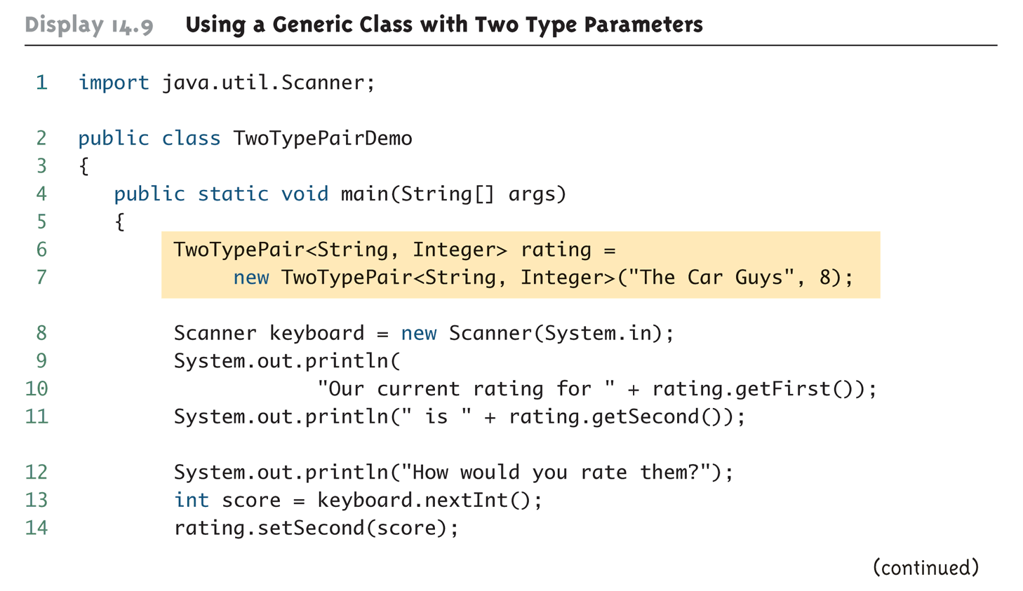
Using a Generic Class with Two Type Parameters (Part 1 of 2)

Slide 25
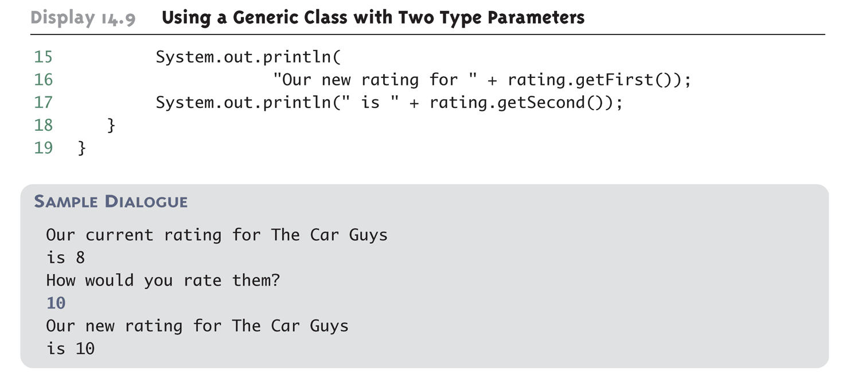
Using a Generic Class with Two Type Parameters (Part 2 of 2)

Slide 26
Generic Methods
When a generic class is defined, the type parameter can be used in the definitions of the methods for that generic class
In addition, a generic method can be defined that has its own type parameter that is not the type parameter of any class
A generic method can be a member of an ordinary class or a member of a generic class that has some other type parameter
The type parameter of a generic method is local to that method, not to the class

Slide 27
Generic Methods
The type parameter must be placed (in angular brackets) after all the modifiers, and before the returned type
public static <T> T genMethod(T[] a)
When one of these generic methods is invoked, the method name is prefaced with the type to be plugged in, enclosed in angular brackets
String s = NonG.<String>genMethod(c);

